Slide 1
Ngā Kōti Rangatahi o Aotearoa
“Ka pū te ruha, ka hao te rangatahi!”
“The old net is cast aside, the new net goes fishing!”
Rangatahi Courts of New Zealand – An Overview
Australasian Youth Justice Conference, 16–18 November 2021, Online.
Judge Bidois
Ngāti Rangiwewehi, Ngāti Ngāraranui

Slide 2
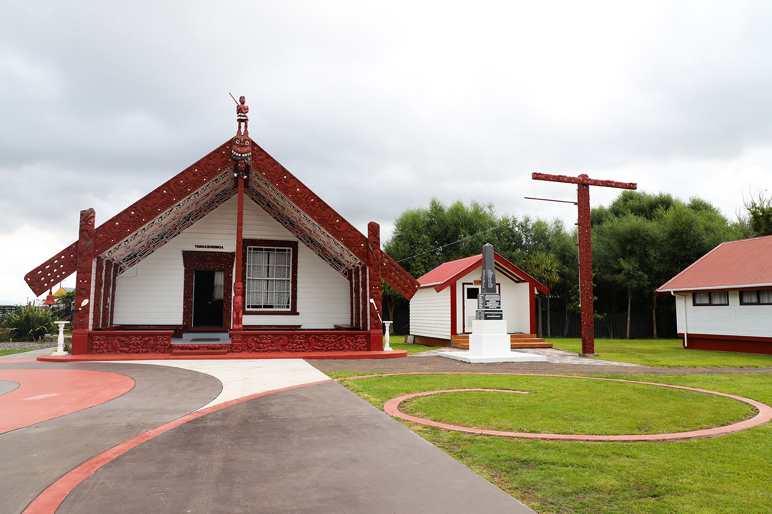
Tarimano Marae, Ngāti Rangiwewehi

Slide 3
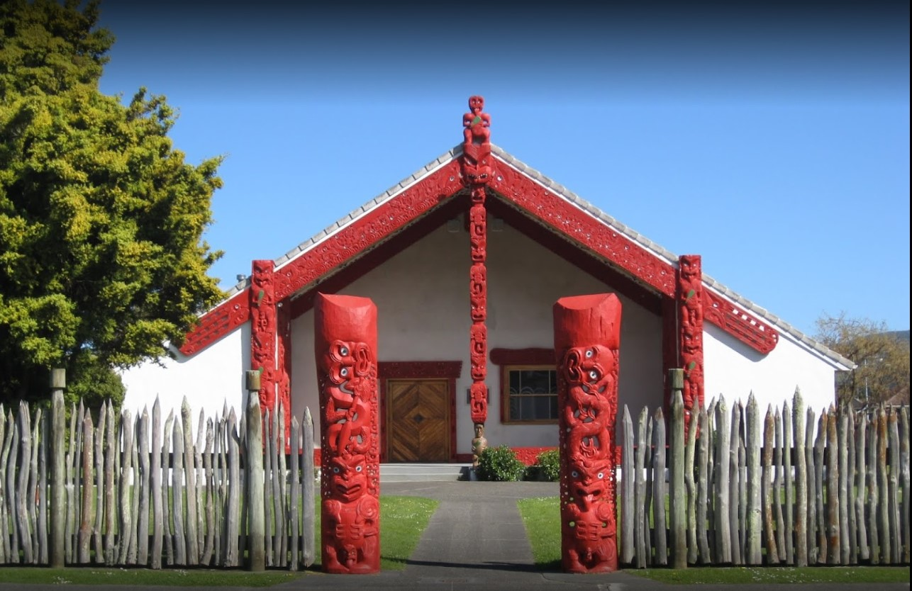
Waiwhetū Marae, Te Āti Awa

Slide 4
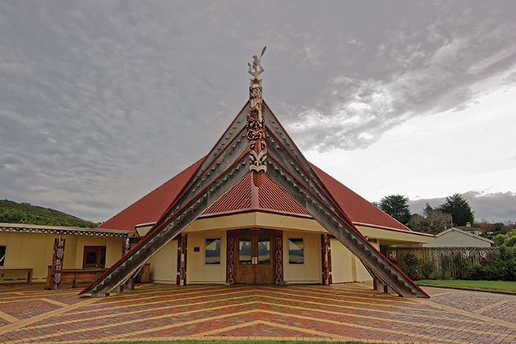
Te Rau Aroha Marae, Ngāi Tahu

Slide 5

Disproportionate Over-representation of Māori
Most important issue in modern day New Zealand Criminal Justice System.

Slide 6
Colonisation
The process of settling among and then controlling the indigenous people of a country

Slide 7
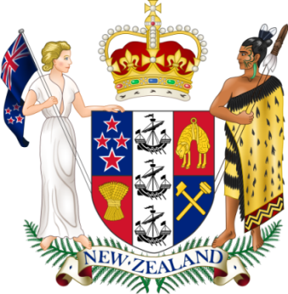
Background
1840 – Treaty of Waitangi
Fundamental cause: Imposition of British law and judicial processes
Assimilation policies
Urbanisation

Slide 8
Background
Introduction of alcohol and later drugs
Incarceration
Alienation of Māori land, individualisation of title
Suppression of Māori language

Slide 9
Progress?
1989 – Pūao-te-Atatū Report
1989 CYPF Act (Children, Young Persons and Their Families Act)
1988 to present date – Statistics have not changed

Slide 10
Progress?
Continuing mainstream processes for Māori in criminal justice system will not change results
Predicted that statistics will become more disproportionate as Māori population increases

Slide 11
Solutions?
Numerous initiatives required to address issue
Pre-charge procedures – broad scope for innovation and improvement, building tribal capacity to work in partnership with police
Court procedures – scope for innovation and improvement
Kaupapa Māori Advisory Group

Slide 12
Youth Profile
Māori
Male
Out of school
Single-parent family
History of care and protection

Slide 13
Youth Profile
Health issues
  Substance abuse
  Mental health
  Exposed to trauma
Disengaged from his/her culture, low expectations, low confidence
Low achievement, minimal contribution

Slide 14
Vision for the Rangatahi
A vision for Māori young people?
  Engaged, high expectations, confident, achieving, contributing, bilingual, bicultural
  He aha te mea nui
  He tāngata he tāngata he tāngata

Slide 15
The Vision for the Rangatahi Court
Motivation: A monocultural and monolingual Youth Court struggles to effectively engage with Māori.
A bicultural process incorporating Māori language and customary protocols.

Slide 16
The Vision for the Rangatahi Court
Held at the marae (traditional venue), with participation of kaumātua, kuia and pakeke (male and female elders and respected adults).
Increased engagement of rangatahi (youth) and their whānau (families) and increased completion of FGC plans.

Slide 17
The Vision for the Rangatahi Court
Opening the Court to the strength and wairua (spirit) of the marae and the local Māori community.
Use of lay advocates
Better victim notification and outcomes

Slide 18
The First Rangatahi Court
Te Kōti Rangatahi o Te Poho-o-Rāwiri
Te Poho-o-Rāwiri Marae, Gisborne
First sitting: 30 May 2008, Judge H Taumaunu presiding

Slide 19
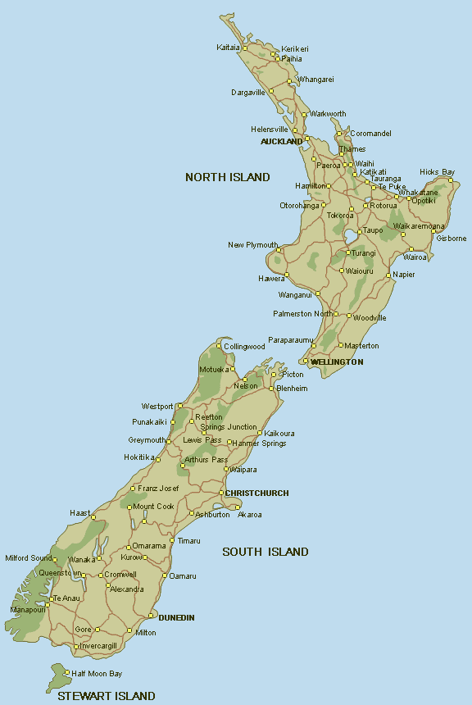
16 Rangatahi Courts Nationwide

Slide 20
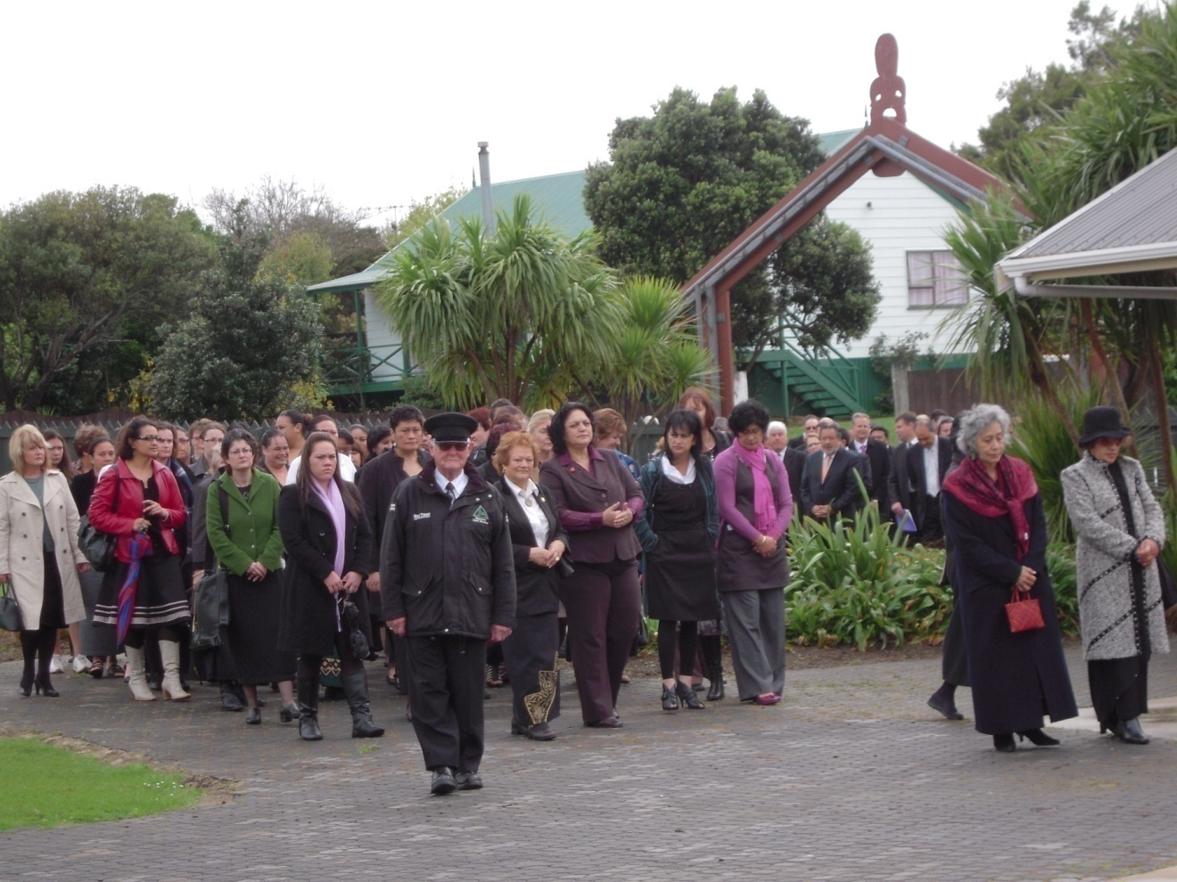
Te Kōti Rangatahi ki Manurewa
Manurewa Marae, South Auckland
First sitting: 23 September 2009, Judge G Hikaka presiding

Slide 21
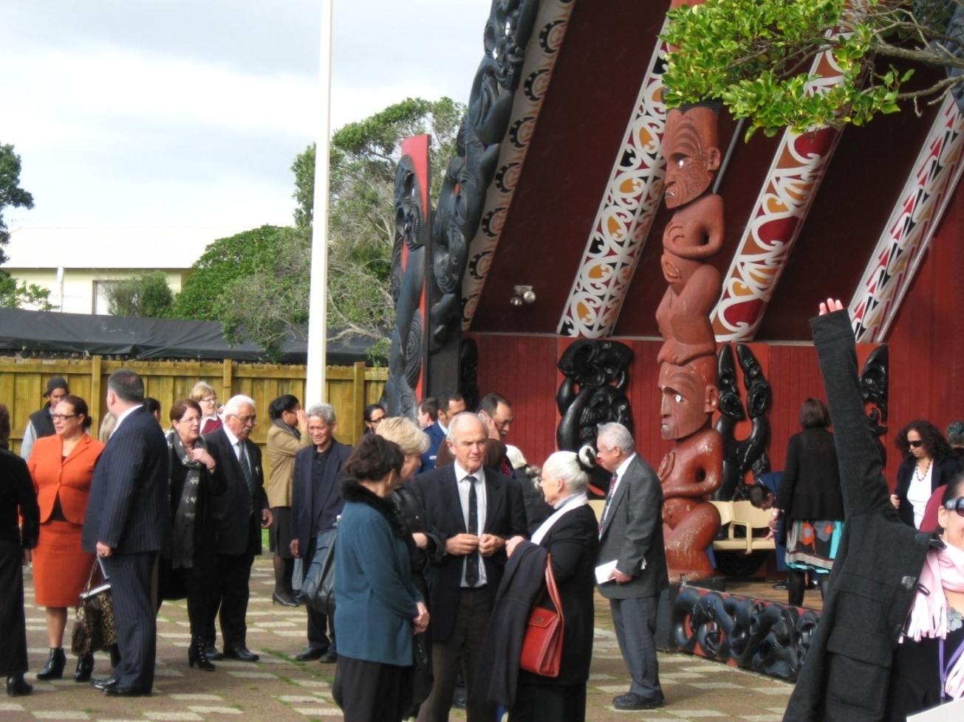
Te Kōti Rangatahi ki Ōrākei
Orakei Marae, Central Auckland
Launch: 23 June 2010, Judge E Paul presiding

Slide 22
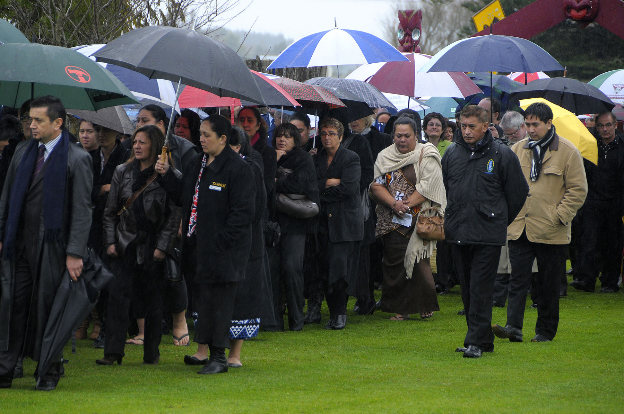
Te Kōti Rangatahi ki Kirikiriroa
Launched at Te Ohaaki Marae, Huntly on 7 August 2010
Sitting at Kirikiriroa Marae, Hamitlon, Judge D Clark presiding

Slide 23
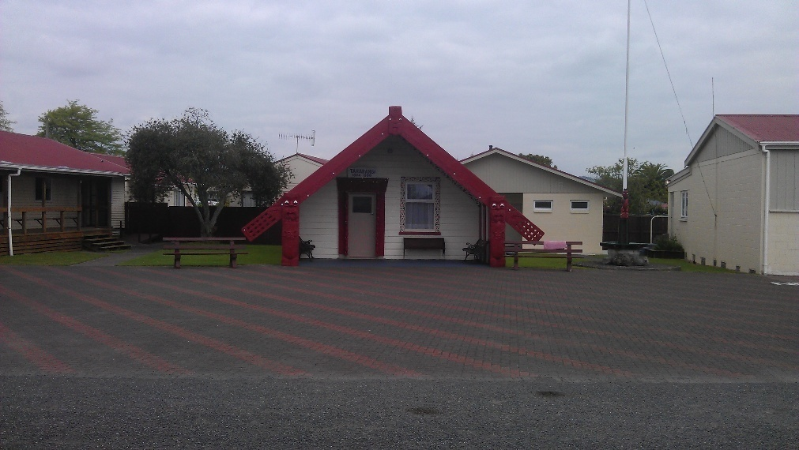
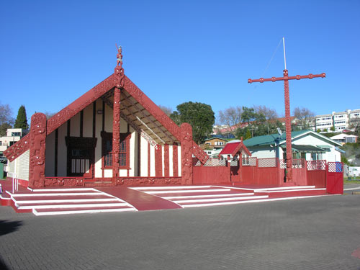
Te Kōti Rangatahi ki Te Arawa
Launched at Ohinemutu Marae, Rotorua on 2 December 2010
Sitting at Taharangi Marae, Rotorua, Judge L Bidois presiding

Slide 24
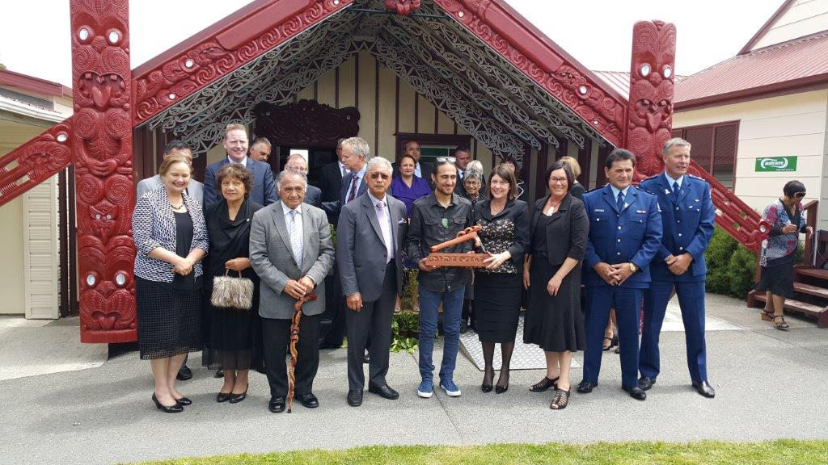
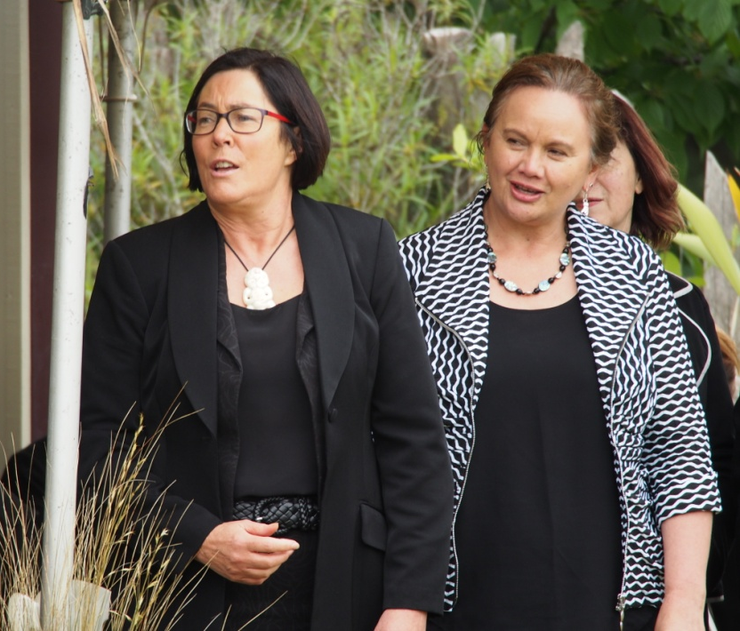
Te Kōti Rangatahi ki Tūwharetoa
Judge Alayne Wills – December 2015

Slide 25
Underlying Principles
Apply the same law
Honour and apply the objects and principles of the Children, Young Persons and Their Families Act 1989.
Hold the young person accountable, and ensure victim’s issues and interests are addressed.

Slide 26
Underlying Principles
Address the underlying causes of the offending.
Seek solutions with the active involvement of whānau, hapū and iwi.
Promote and maintain inter-agency co-operation and accountability

Slide 27
Underlying Principles
Keep communities safer by reducing reoffending.
Use Māori language, culture and protocols as part of the Court process.
All young people can elect to attend

Slide 28
Cultural Aspects of
Rangatahi Court…

Slide 29
Cultural Components
Pōwhiri: traditional ceremony of welcome between tangata whenua (hosts) and manuhiri (visitors)
Karanga: host’s call of welcome
Karanga: visitor’s reply

Slide 30
Cultural Components
Mihi whakatau: host’s speech of welcome to visitors
Waiata tautoko: song to support speech
Mihi whakaeke: visitor’s speech in reply
Waiata tautoko: song to support speech

Slide 31
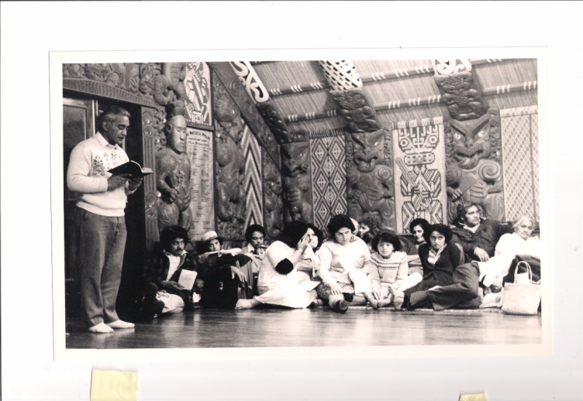
Cultural Aspects of Rangatahi Court
Koha: visitor’s gift to hosts
Hongi: pressing of noses, sharing of breath
Hākari: sharing of food
Rangatahi Pepeha: young person’s introduction
Marae Kawa: customs of the marae and wharenui
Tikanga: customs, correct way of doing things

Slide 32
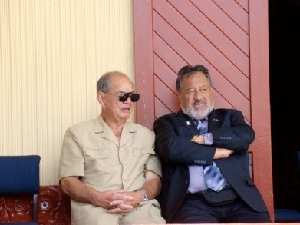
Features of Rangatahi Courts
Enhanced by use of Marae as a venue
Enhanced by involvement of elders and Lay Advocates

Slide 33
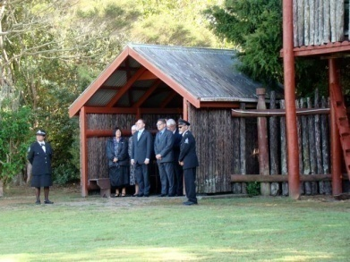
Features of Rangatahi Courts
Court process culturally appropriate by incorporation of Māori custom, protocol and reo

Slide 34
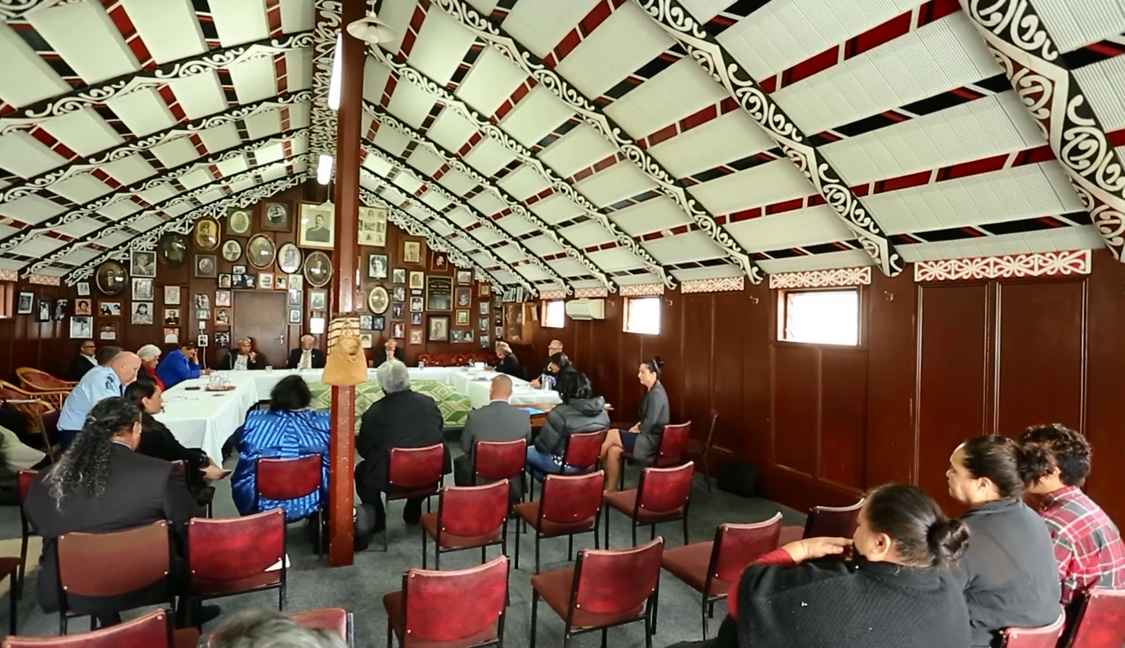
Set Up

Slide 35
Qualitative Evaluation (2012)
Evaluation strongly endorsed the Rangatahi Courts –
  Consistent operational process
  Positive early outcomes for young people, whānau, victims, agencies and marae communities
Identifies good practice responses to key challenges faced by the Rangatahi Courts.

Slide 36
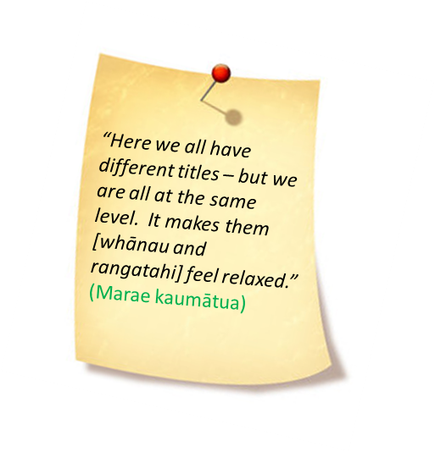
Qualitative Evaluation (2012)
Notes:
Missing sound byte for ‘female rangatahi’

Slide 37
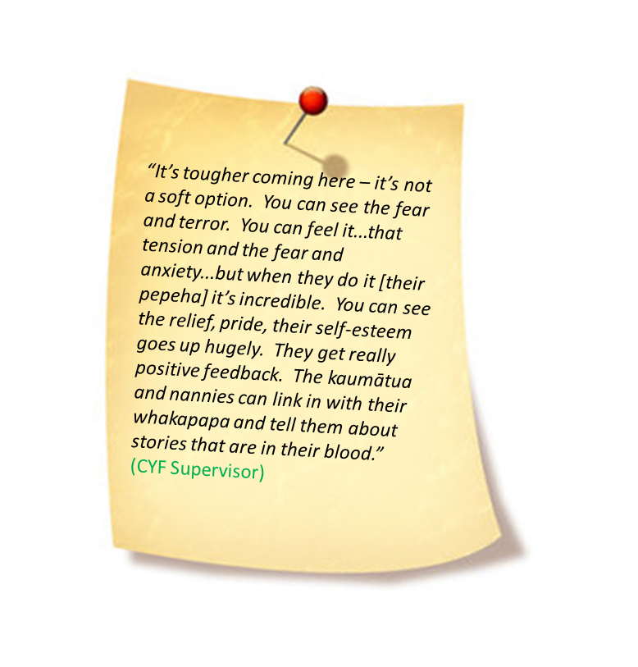
Qualitative Evaluation (2012)
Notes:
Missing sound byte for ‘female rangatahi’

Slide 38
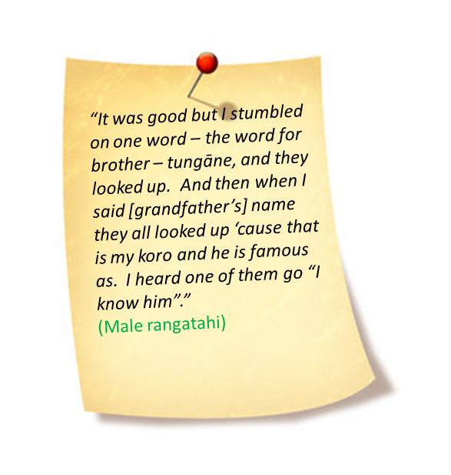
Qualitative Evaluation (2012)
Notes:
Missing sound byte for ‘female rangatahi’

Slide 39
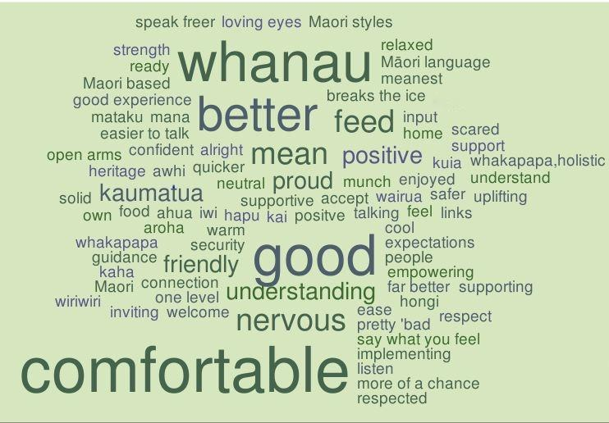
Qualitative Evaluation (2012)

Slide 40
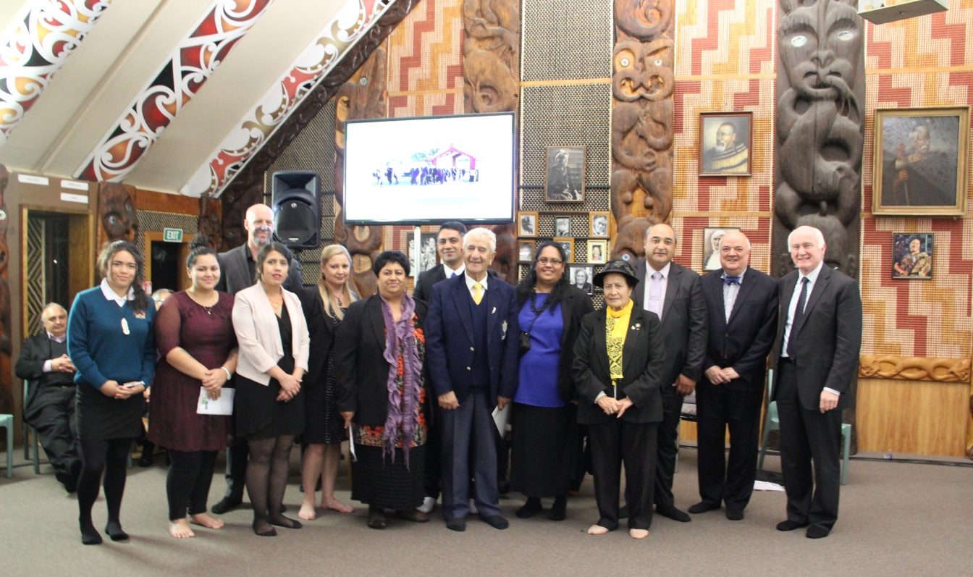
Australasia Institute of Judicial Administration
Award for Excellence in Judicial Administration - 2015
Internationally recognises the successful collaboration between the Youth Court and Māori and Pasifika communities to improve access to justice for young people.
Notes:
This award is designed to recognise a significant contribution to the furtherance of judicial administration.
Internationally recognises the collaboration between the Youth Court and Māori and Pasifika communities to improve access to justice for young people.
Affirms the importance of engaging with communities, whānau, hapū and iwi to provide culturally appropriate and relevant processes that reconnect young people with their cultural identities.
Recognises and honours everyone involved in developing and delivering Rangatahi and Pasifika Courts in New Zealand.

Slide 41
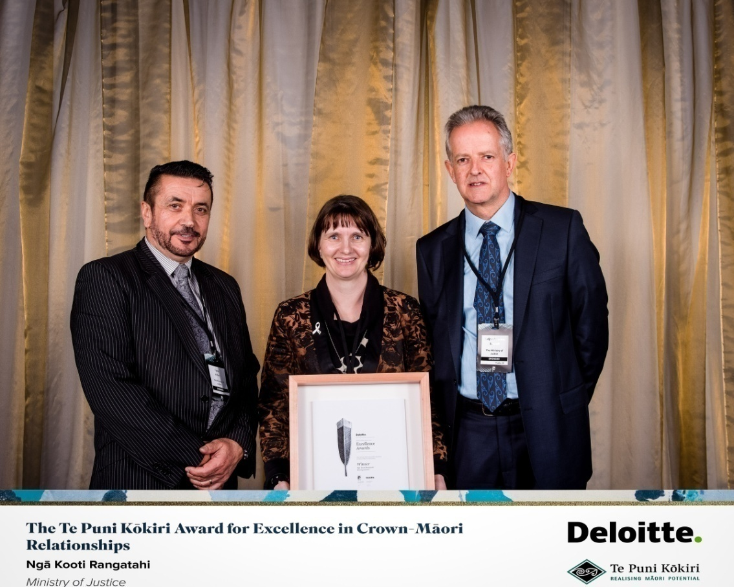
Institute of Public Administration New Zealand
Award for Excellence in Crown/Māori Relationship - 2016
Recognises and celebrates outstanding performance in the public sector, and the difference sector professionals make to the lives of New Zealanders.

Slide 42
The Future
Concerted multi-level strategies required to address disproportionate over-representation. Everyone must do what they can within their own sphere of influence.
Ngā Kōti Rangatahi - “… one of many necessary steps in the right direction along a difficult and long road ahead.”
“Kua takoto te mānuka, aue tū ake ra!” – The challenge has been laid down, so rise up and accept the challenge.

